Slide 1


Python Coding Session Data Structures Methods and Attributes
Introduction to Implementation Details and Usage

Slide 2

Introduction
In Python, objects have both methods and attributes. Methods are functions associated with objects that can perform actions or operations on the object, while attributes are variables associated with objects that hold data related to the object

Slide 3
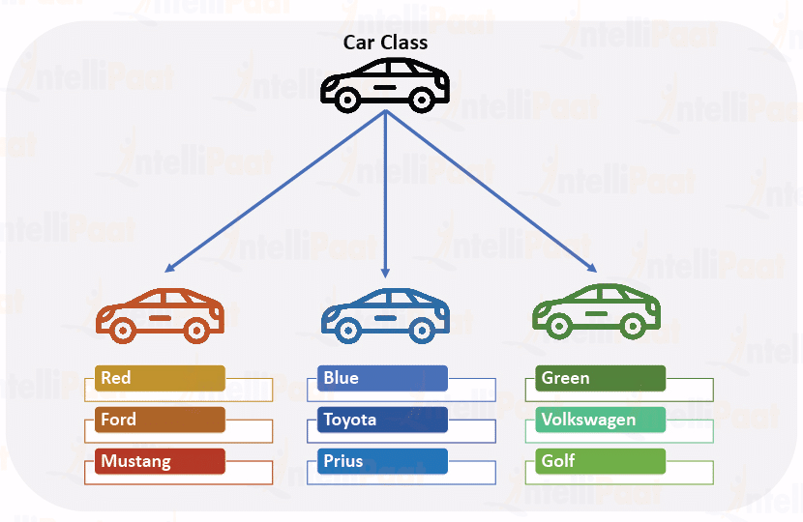
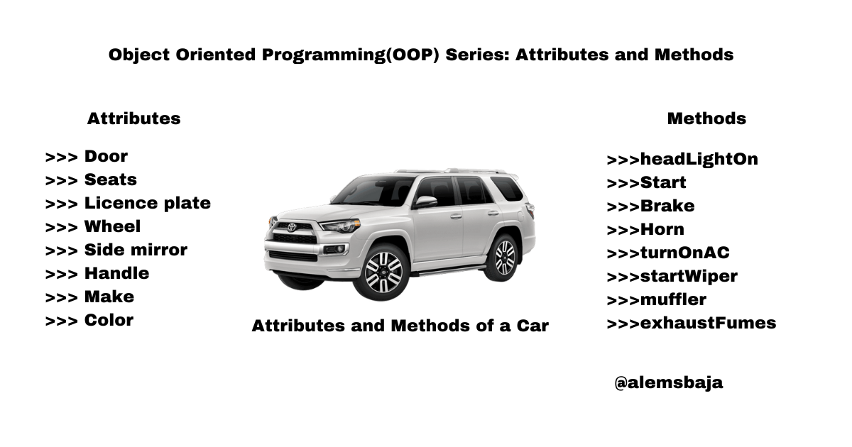
Python Objects

Slide 4
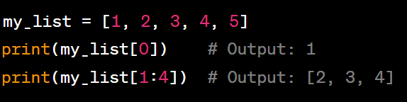
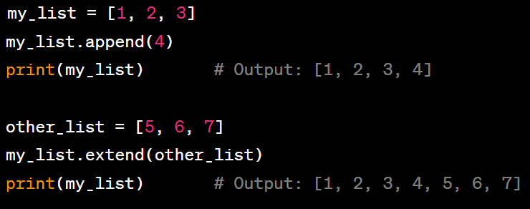
List Methods and Attributes
Indexing and Slicing
Appending and Extending

Slide 5
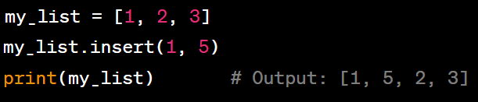
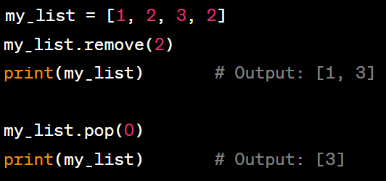
List Methods and Attributes
Inserting Elements
Removing Elements

Slide 6
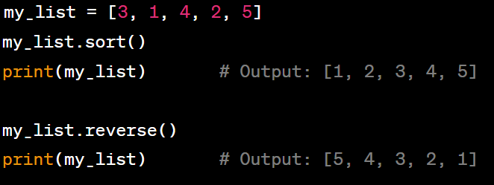
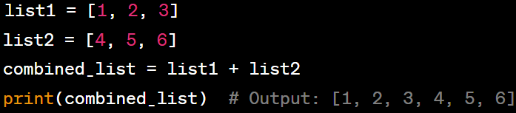
List Methods and Attributes
Sorting and Reversing
Concatenating

Slide 7

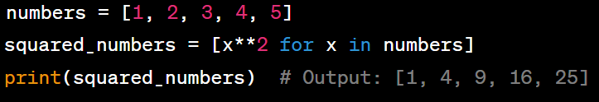
List Methods and Attributes
Counting Elements
List Comprehension

Slide 8

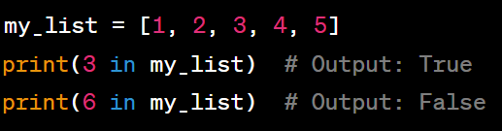
List Useful Resources
Length of List
Checking Membership

Slide 9
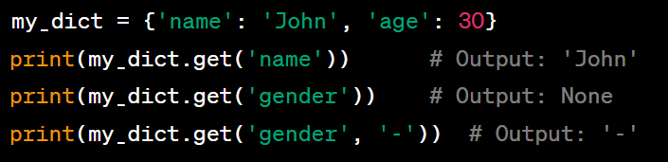
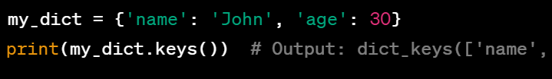
Dictionary Methods and Attributes
Selecting Elements
Getting Keys

Slide 10
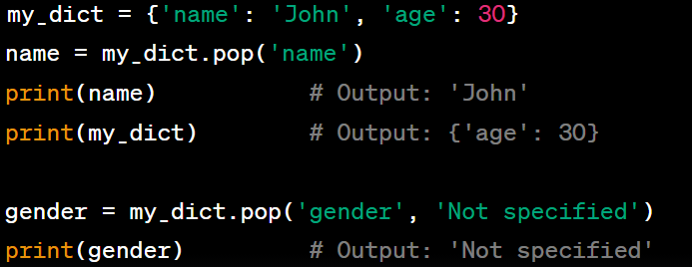
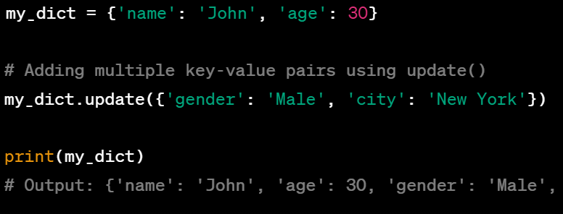
Dictionary Methods and Attributes
Removing Elements
Adding Elements

Slide 11
Pratice
Exercise: Student Scores Create a dictionary to store the scores of three students. Ask the user to input the names of the students and their corresponding scores. After taking input, calculate and print the average score of the students.
Exercise: Word Frequency Counter Write a function that takes a string as input and returns a dictionary containing the frequency of each word in the string. Ignore punctuation and make the comparisons case-insensitive.
Exercise: List Reversal Write a function that takes a list as input and returns a new list with the elements reversed.
Exercise: Sorting Lists Write a function that takes a list of numbers as input and returns a new list with the elements sorted in ascending order.
Exercise: Even Numbers Write a function that takes a list of numbers as input and returns a new list containing only the even numbers.

